Slide 1
Logistics: Project Milestone 2
Milestone 2: Due Nov 4
Summarize your progress
Should make enough progress to know whether the project is feasible
Last chance to convert a research project to an extensive literature survey
Midterm Pitch: Nov 1 (Tue), in lecture
Opportunity to engage other classmates
Format
Every group gives a 1-min elevator pitch about their projects
Data collection: Sign up by tomorrow if you want to collect data from the entire class
Group discussions
Three big groups, with 3~4 teams per group
Each team gets 10~12 minutes of time from other teams
Everyone is expected to attend

Slide 2
Logistics: Project Milestone 2
More on Midterm Pitch: Nov 1 (Tue)
What to do beforehand
Prepare a 1-min elevator pitch about your project
Prepare a 1-page slide and send it to me before noon next Tuesday
Think about how to utilize the discussion time
Let me know by this Wednesday if you plan to engage the entire class

Slide 3
Student Presentation
Remember to submit the peer review form by 6pm

Slide 4
Lecture 15 Non-Independent Work
Instructor: Chien-Ju (CJ) Ho

Slide 5

Human Computation
Flower
Dog
Cute
…
“Crowd”
Input
Black Box
Output

Slide 6
Open the Black Box
Flower
Dog
Cute
…
Human as data sources:
Label aggregation
Probabilistic reasoning to aggregate noisy human data
Humans are “Humans”:
Incentive design
Game theoretical modeling of humans and incentive design

Slide 7
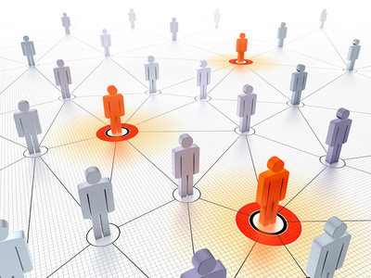
The Crowd is Connected
Flower
Dog
Cute
…
A Connected Crowd

Slide 8
Beyond the Independent Workers

Slide 9
Designing Workflows
Some workers are asked to perform improvement tasks
Some workers are asked to vote on whether the improvement is good
Little et al. “TurKit: Tools for Iterative Tasks on Mechanical Turk”. HCOMP 2009

Slide 10
Expert Sourcing and Teams
Dynamically assembling a team of experts from crowd

Slide 11
Collaborative Argumentation

Slide 12
Peer Instruction: Communication helps in education

Slide 13
How Peer Instruction Works

Slide 14
[Crouch and Mazur. 2001]

Slide 15
Can we apply similar ideas in crowdsourcing?
Leveraging Peer Communication to Enhance Crowdsourcing. Wei Tang, Chien-Ju Ho, and Ming Yin. WWW 2019

Slide 16
Peer Instruction => Peer Communication
Apply the idea in crowdsourcing
Recruit a pair of workers
Each complete and submit the task on his/her own
Discuss with another worker for 2 min
Decide whether to revise the answer
Research Questions:
Does peer communication lead to higher quality of work?
Are there spill-over effects?

Slide 17
Experiment Design
Task Types:
Independent tasks: work individually
Discussion tasks: work with peer communication
A naïve experiment design
Post two HITs
One with independent tasks
One with discussion tasks
Measure the end results
What might go wrong?
Self selection (the worker population won’t be the same across treatments)

Slide 18
Experiment Design
Goal of our experiment design
Ensure there won’t be self selection concerns
Be able to answer the two research questions
Q1: Does peer communication lead to higher quality of work?
Q2: Are there spill-over effects?

Slide 19
Peer Communication Leads to Better Work

Slide 20
Long-term Performance Might Not Improve
Might be due to the design
Need longer communication time?
Need feedback?

Slide 21
Does Diversity in Communication Help?
Not that trivial [Duan et al. HCOMP 2020]
Example:
Diversity in (artificial) skills

Slide 22
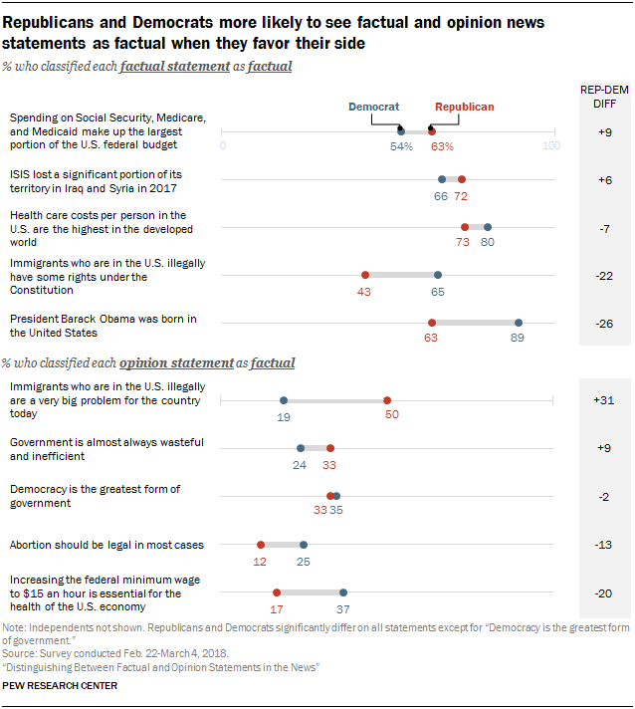
Does Diversity in Communication Help?
Diversity in perspectives (Republicans/Democrats)
Opinions or factual statements

Slide 23
Does Diversity in Communication Help?
Not that trivial [Duan et al. HCOMP 2020]
A couple of designs are tested; none lead to significant improvements
Could be that the designs happen to not work
Or could be due to that the “micro” properties of tasks in crowdsourcing

Slide 24
Peer Communication and Network
Broader question
Peer communication is an edge (point to point) of a network
Design better network topology?
What do we mean by better
What if we can’t design network
Networks are already there
The influences are also there
What’ll happen?

Slide 25
Discussion
What can you do to utilize the network/communication to improve crowdsourcing or to achieve social good in general?
What are the potential drawbacks given that humans are in the network and are influenced/biased by others (e.g., echo chambers)? What might we do to address that?

Slide 26
Hard but Important Questions
”we find that belief exchange in structured bipartisan networks can significantly improve the ability of both conservatives and liberals to interpret climate data, eliminating belief polarization.”
“Republican participants expressed substantially more conservative views after following a liberal Twitter bot, whereas Democrats’ attitudes became slightly more liberal after following a conservative Twitter bot”

